Slide 1

Tree Traversal
Rem Collier
Room A1.02
School of Computer Science and Informatics
University College Dublin, Ireland

Slide 2
Tree Traversal
Systematic way of “visiting” or “processing” each node in the tree.
A very common operation:
print out each node’s label
add 10 to each node’s label
examine each node to find label “Elvis”
count total number of nodes
…
Q: But in which order are nodes visited??
A: many “standard” orders:
pre-order traversal
in-order traversal
post-order traversal
Euler traversal
breadth-first traversal (all nodes at depth=0, then depth=1, then depth=2)
Cover these now breadth first: discussed in graphs

Slide 3
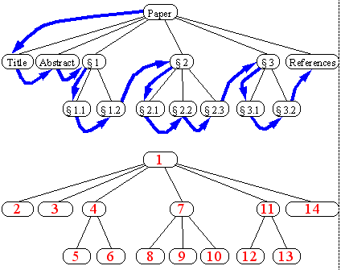
Pre-Order Tree Traversal
preorder traversal
Algorithm preOrder(v)
“visit” node v
for each child w of v do
recursively perform preOrder(w)
EXAMPLE - reading a document from beginning to end
Don’t read a section until read all prior sections

Slide 4
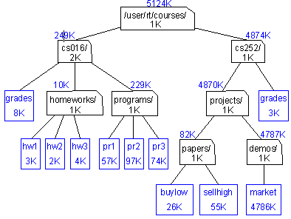
Post-Order Tree Traversal
postorder traversal
Algorithm postOrder(v)
for each child w of v do
recursively perform postOrder(w)
“visit” node v
du (disk usage) command in Unix
to compute value for parent,
must first visit
all children

Slide 5
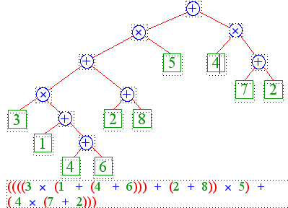
In-Order Tree Traversal
inorder traversal of a binary tree (inapplicable to non-binary trees)
algorithm inOrder(v)
recursively perform inOrder(leftChild(v))
“visit” node v
recursively perform inOrder(rightChild(v))
printing an arithmetic expression
specialization of an inorder traversal
print “(“ before traversing the left subtree
print “)” after traversing the right subtree
print operator between children

Slide 6
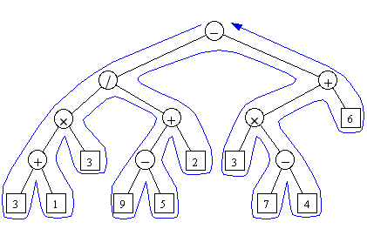
Euler Tour Tree Traversal
Generic traversal of a binary tree
the preorder, inorder, and postorder traversals are special cases of the Euler tour traversal
“walk around” the tree and visit each node three times:
on the left
from below
on the right

Slide 7
Comparison: Traversal Algorithms
preOrder:
1. visit this node
2. preOrder left child
3. preOrder right child
only difference is when this step occurs
inOrder:
1. inOrder left child
2. visit this node
3. inOrder right child
postOrder:
1. postOrder left child
2. postOrder right child
3. visit this node
Euler:
1. visit this node
2. postOrder left child
3. Visit this node
4. postOrder right child
5. visit this node

Slide 8
Insert: The Visitor Pattern
Design Pattern: a general reusable solution to a commonly occurring problem within a given context in software design.
Visitor Pattern: a standard way of implementing tree traversal.
public interface Visitor<T> {
public void visit(Position<T> position, Object data);
}
Example: TreePrinter
Generates a String representation of a tree using indentation to indicate the level of each node.

Slide 9
Insert: Visitor Pattern
public class PreOrderPrinter<T> implements Visitor<T> {
private Tree<T> tree;
private StringBuffer buf = new StringBuffer();
public TreePrinter(Tree<T> tree) { this.tree = tree; }
public void visit(Position<T> position, Object data) {
buf.append(data.toString());
buf.append(position.element().toString());
buf.append("\n");
Iterator<Position<T>> it = tree.children(position);
while (it.hasNext()) {
visit(it.next(), data+"\t");
}
}
public String toString() {
return buf.toString();
}
}

Slide 10
Insert: Visitor Pattern
public class PostOrderPrinter<T> implements Visitor<T> {
private Tree<T> tree;
private StringBuffer buf = new StringBuffer();
public TreePrinter(Tree<T> tree) { this.tree = tree; }
public void visit(Position<T> position, Object data) {
Iterator<Position<T>> it = tree.children(position);
while (it.hasNext()) {
visit(it.next(), data+"\t");
}
buf.append(data.toString());
buf.append(position.element().toString());
buf.append("\n");
}
public String toString() {
return buf.toString();
}
}

Slide 11
Insert: Visitor Pattern
public class InOrderPrinter<T> implements Visitor<T> {
private BinaryTree<T> tree;
private StringBuffer buf = new StringBuffer();
public TreePrinter(BinaryTree<T> tree) { this.tree = tree; }
public void visit(Position<T> position, Object data) {
visit(tree.leftChild(position), data+”\t”);
buf.append(data.toString());
buf.append(position.element().toString());
buf.append("\n");
visit(tree.rightChild(position), data+”\t”);
}
public String toString() {
return buf.toString();
}
}

